Slide 1
Cardiovascular Diseases Detection & Diagnosis

Slide 2
Hridam
IBM Mentor
Mr. JEYA PRAKASH MUTHUKRISHNAN
Edunet Mentor
Mr. Nashit Humam
Ambika Ajai Singh
Ashish Gupta
Atul Srivastava
Sakshi Chaurasia
Student Name

Slide 3
Workload Division
Contribution of each team member in project
Ambika: Idea, Model Creation, Project Development
Ashish: Exploring Algorithms to be used
Atul: Looking for resources to serve as reference for UX
Sakshi: Think about the UI , Design the UI part

Slide 4
The Background
Include historic background about the problem and past/current scenarios

Slide 5
Problem Statement
Analyze health data to develop a model that predicts potential cardiovascular diseases risk in different sections of the population.
Identify the major risk factors contributing to cardiovascular diseases worldwide.

Slide 6
Proposed Solution
Understanding and dealing with these factors through lifestyle changes, regular check-ups, and early treatment are vital to preventing and managing heart disease. Machine learning models can use these factors to predict a person’s risk and provide personalized precautions.

Slide 7
Solution Design
Data Preprocessing: Clean and preprocess the dataset to handle missing values, normalize features, and convert categorical variables into a suitable format for machine learning models.
Feature Selection: Identify and select the most relevant features for the prediction model to improve accuracy and reduce computational complexity.
Model Evaluation: Employ appropriate evaluation metrics such as accuracy, precision, recall, and F1-score to assess the machine learning model’s performance.
Hyperparameter Tuning: Fine-tune the parameters of the chosen algorithm to optimize the model’s performance.
Validation and Testing: Split the dataset into training, validation, and testing sets to ensure the model generalizes well to new, unseen data.

Slide 8
Technology Stack & Requirements
Technology Stack
Frontend: Streamlit (UI/UX),
Backend: Python , Scikit-learn, Machine Learning
Data Handling: Pandas, NumPy
Data Visualization : Matplotlib , Seaborn
Database: SQLite

Slide 9
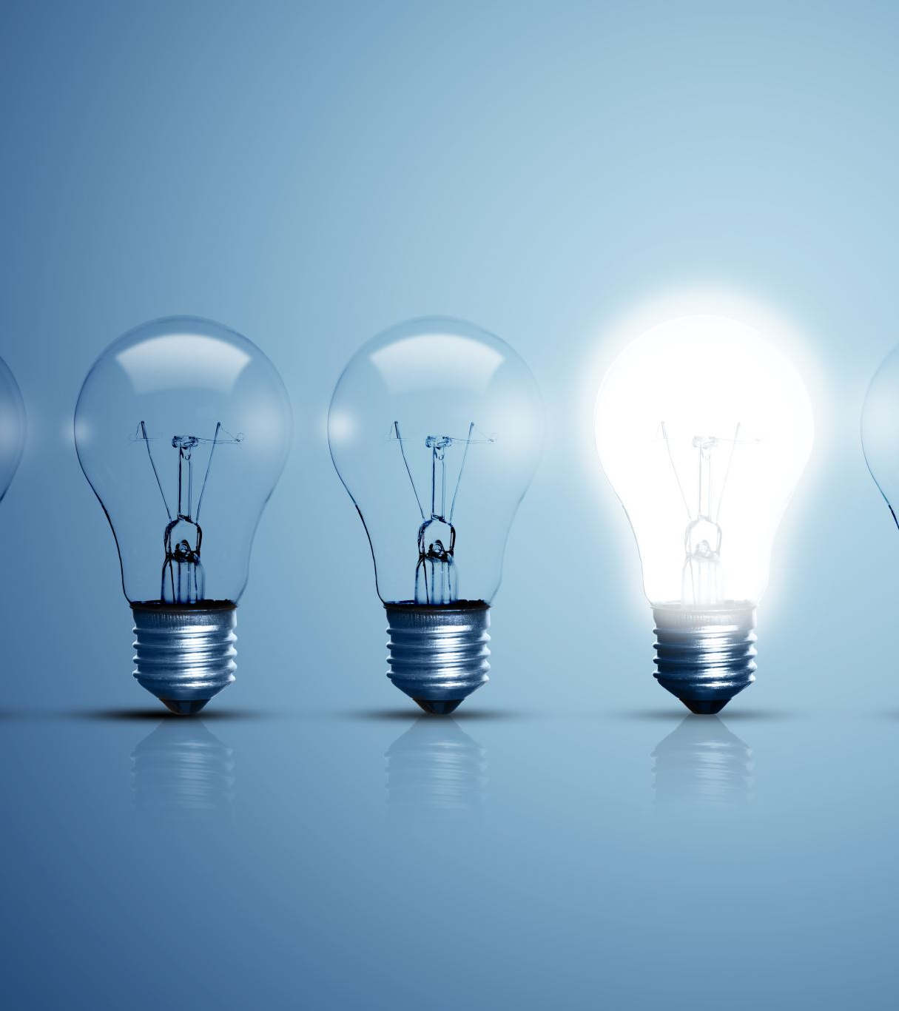
Innovative Idea
Understanding Heart disease prediction uses machine learning algorithms to analyze medical data and detect patterns that could suggest potential heart problems. This approach enables early detection and timely intervention, ultimately saving lives.
It can predict any type of heart disease before anything happen.

Slide 10
Results / Outcomes / Analysis
Personalized Risk Assessment: Customizing predictions based on a person’s health profile improves accuracy, enabling personalized preventive measures.
Real-Time Monitoring: Continuous monitoring of health parameters in real time enables quick action in case of abnormalities, reducing response time and improving patient outcomes.
Data analysis Perspectives: Machine learning analyzes large data sets to find patterns and trends, helping healthcare professionals make better decisions.

Slide 11

Limitations
Data Quality: In healthcare, ensuring that the data used for training machine learning models is reliable and accurate is difficult. There are often issues with the quality and consistency of data sources.
Interpretability: Some machine learning models’ “black box” nature can make it challenging for healthcare professionals to understand and trust the predictions, hindering widespread adoption.
Ethical Concerns: Ensuring patient privacy, data security, and ethical use of healthcare data are critical challenges in developing and deploying machine learning systems in healthcare.
Clinical Adoption: To use machine learning predictions in healthcare, we must address challenges like resistance to change and lack of awareness or training among healthcare professionals.
Ethical Concerns: Ensuring patient privacy, data security, and ethical use of healthcare data are critical challenges in developing and deploying machine learning systems in healthcare.

Slide 12

Future Enhancements/Scope
Enhancing model accuracy through continuous data refinementState more innovative ideas that can be implemented
Extend the system to a broader demographic for comprehensive health monitoring.

Slide 13
The Demo showcasing the working solution/prototype Project link

Slide 14
Thank You

